Slide 1

Introduction
TEAM 1:
Yen Hoang
Knight Zablon
Zahra Dasizadeh
Maryan Hussein
Emad Ameri

Slide 2
Bronze layer
Extract data from API
Download the CVS
Create a database and schema on Snowflake
Upload the CVS file into a table

Slide 3
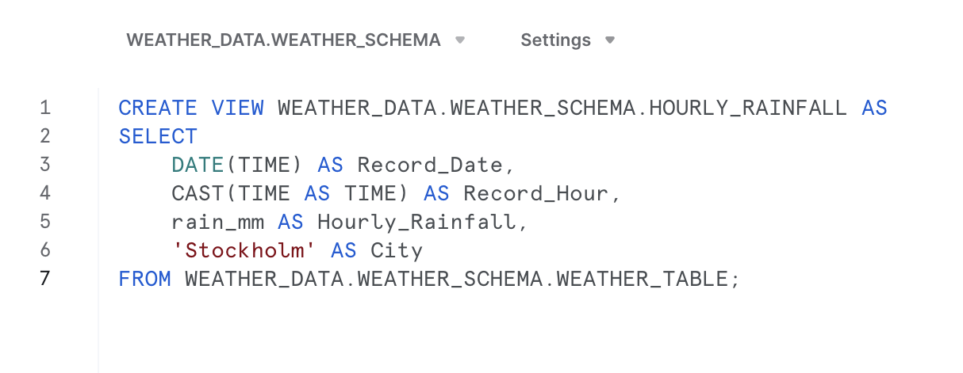
Silver layer

Slide 4
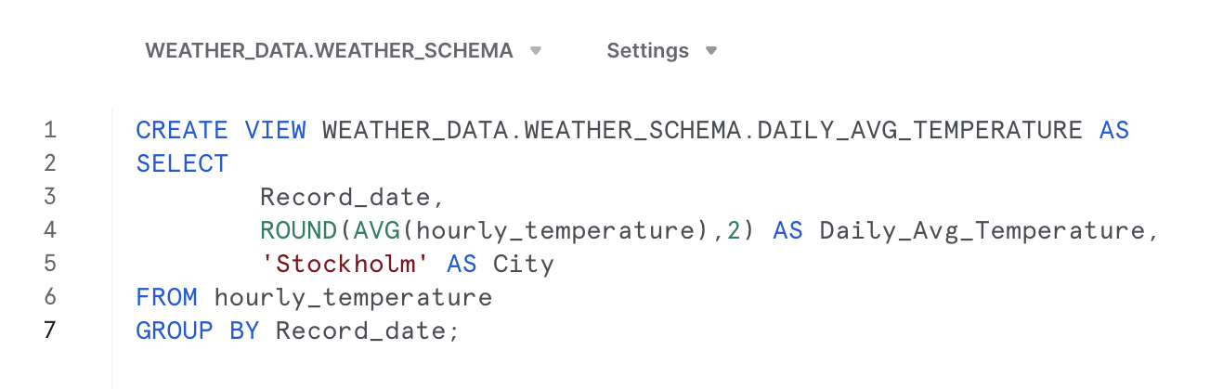
Gold layer
Average

Slide 5
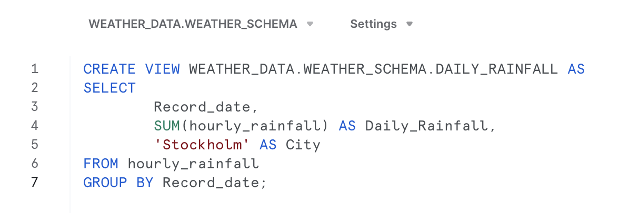
Gold layer
SUM

Slide 6
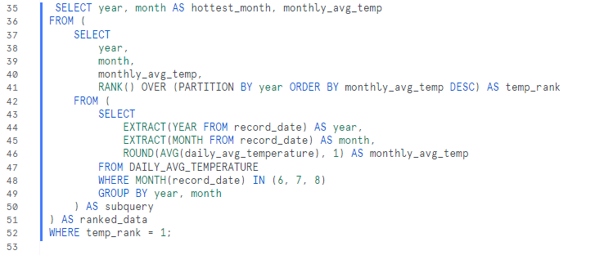
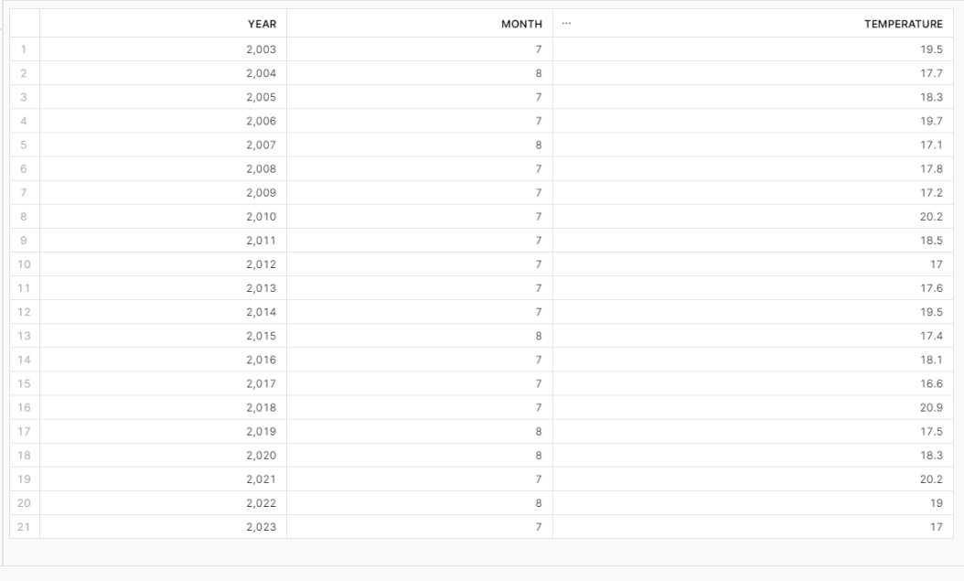
Q1: Which was the hottest summer month and what was the temperature each year?

Slide 7
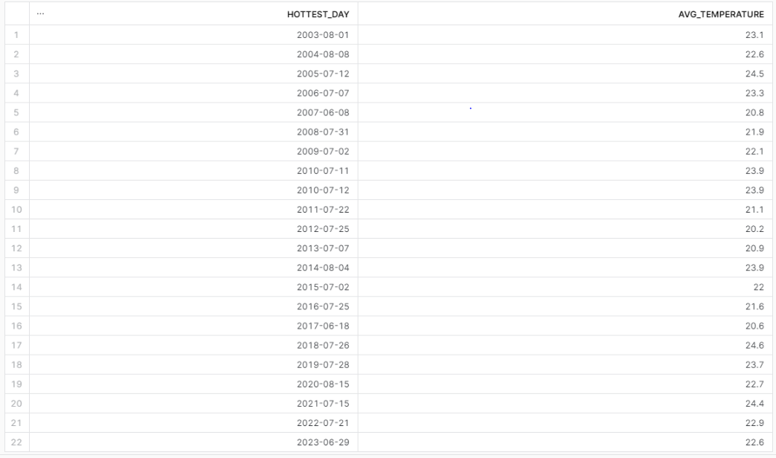
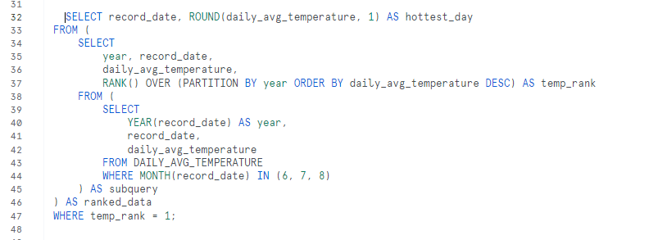
Q2: Which was the hottest day in the summer months and what was the temperature each year?

Slide 8
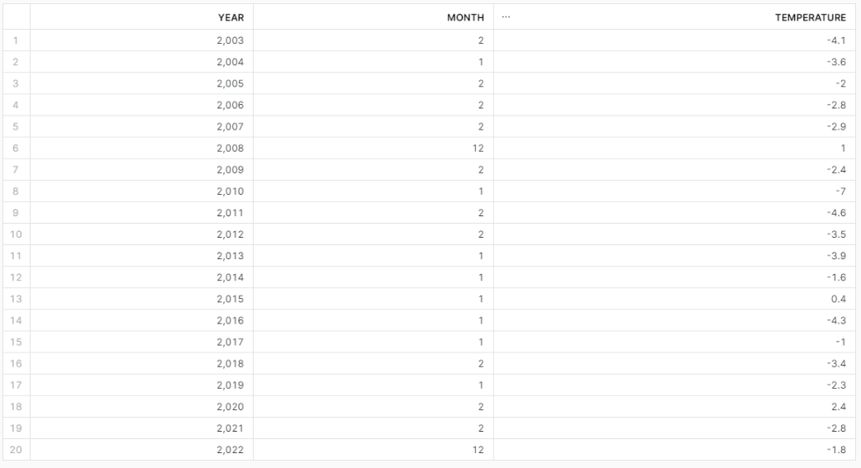
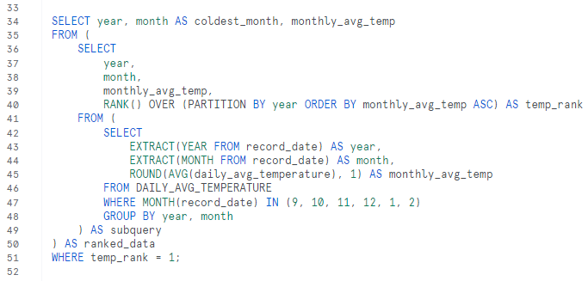
Q3: Which was the coldest winter month and what was the temperature each year?

Slide 9
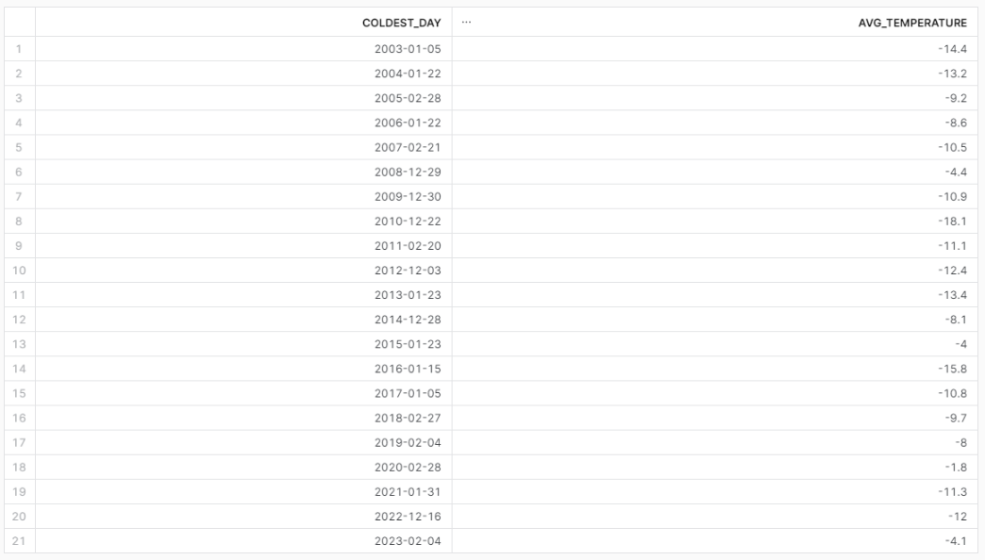
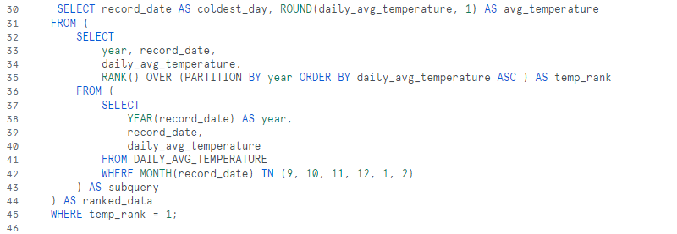
Q4: Which was the coldest day in the winter months and what was the temperature each year?

Slide 10
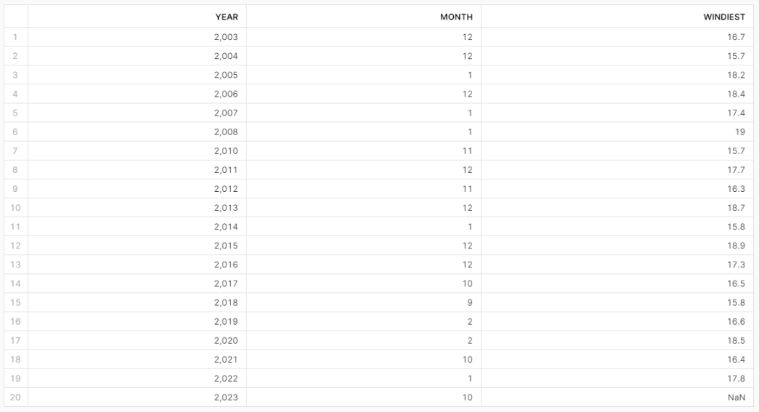
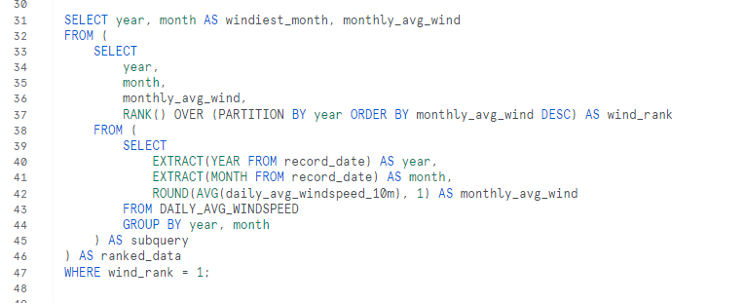
Q5: Which was the windiest month each year and what was the average windspeed?

Slide 11
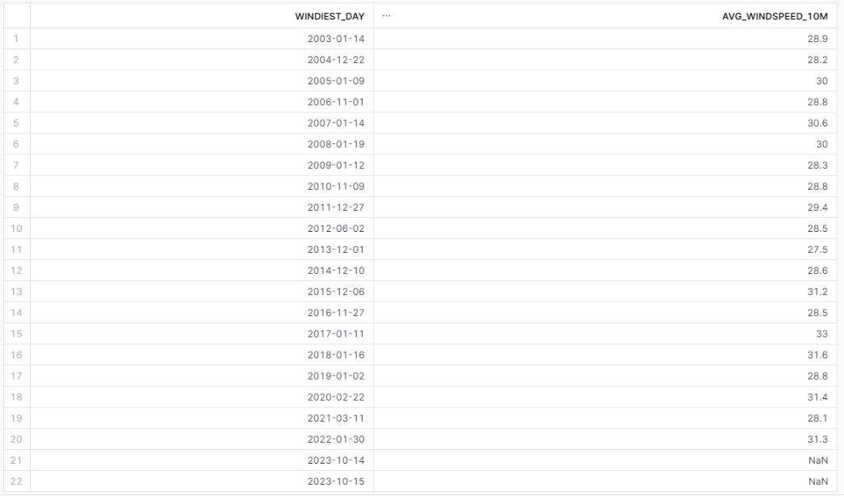
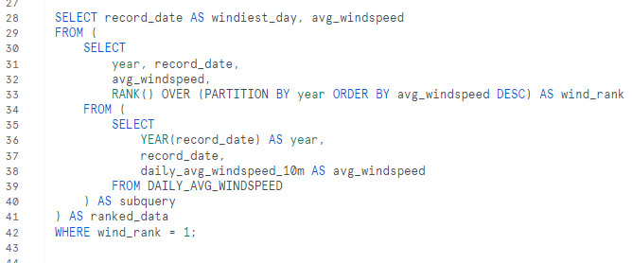
Q6: Which was the windiest day and what was its average wind speed, calculate for each year?

Slide 12
Total rainfall
Q7: Which month had the most rain fall each year?

Slide 13
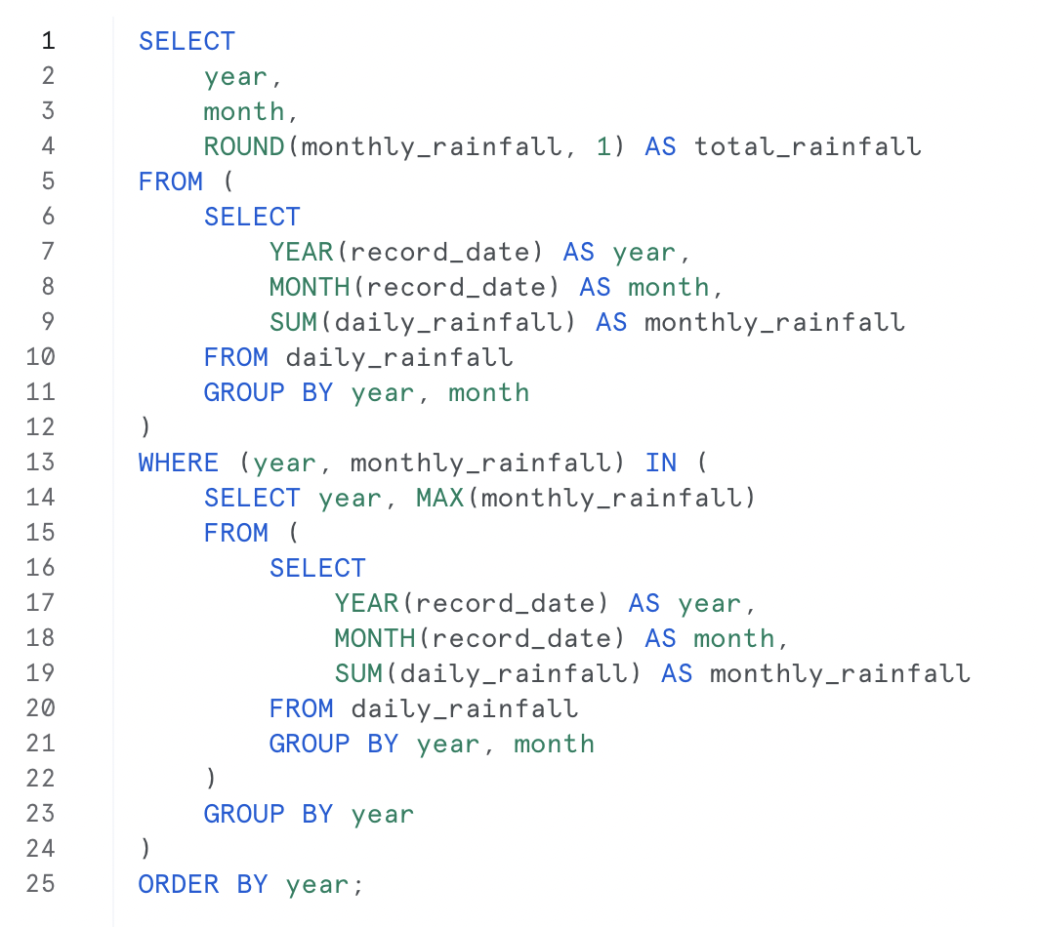

Q7

Slide 14
Total snowfall
Q8: Which month had the most snowfall each year?

Slide 15
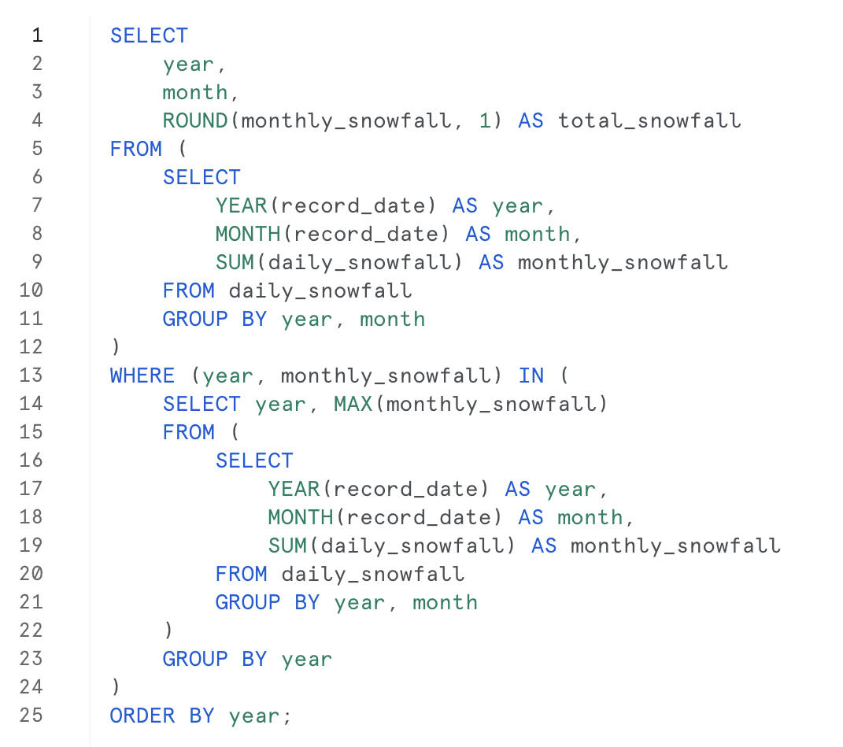

Q8

Slide 16
Spring start
Q9: Which date marked the start of spring each year?

Slide 17
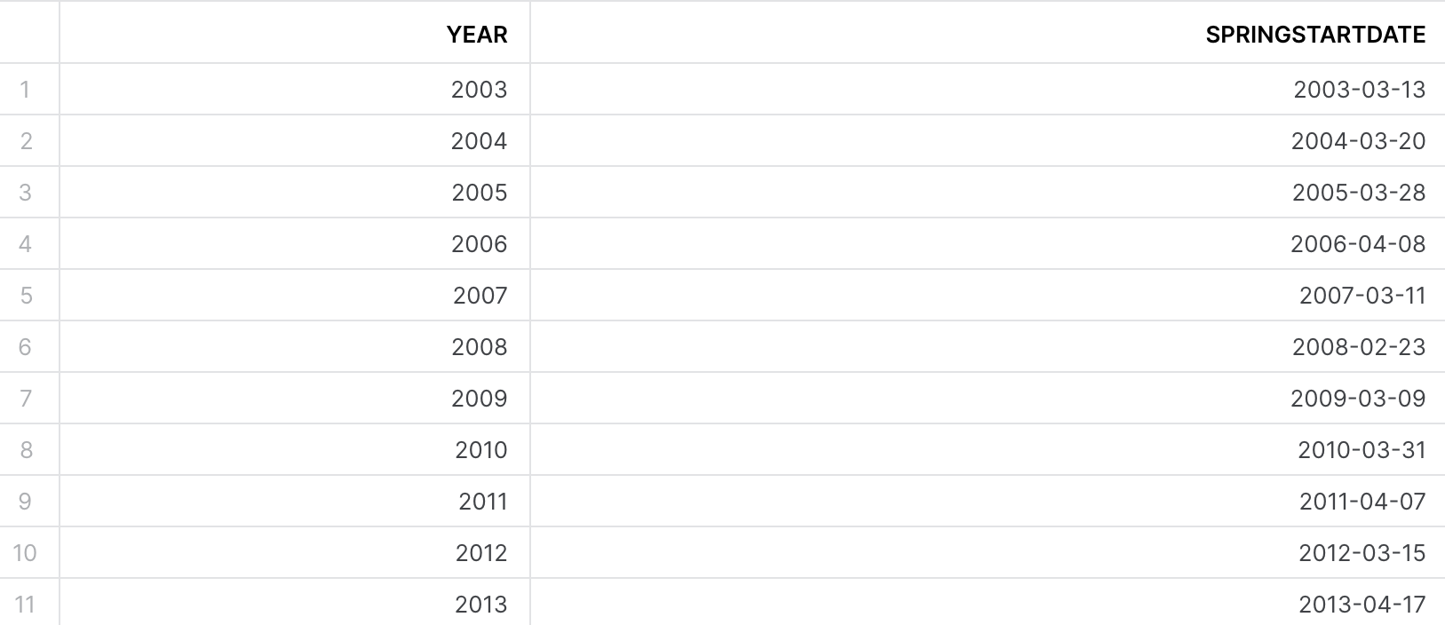
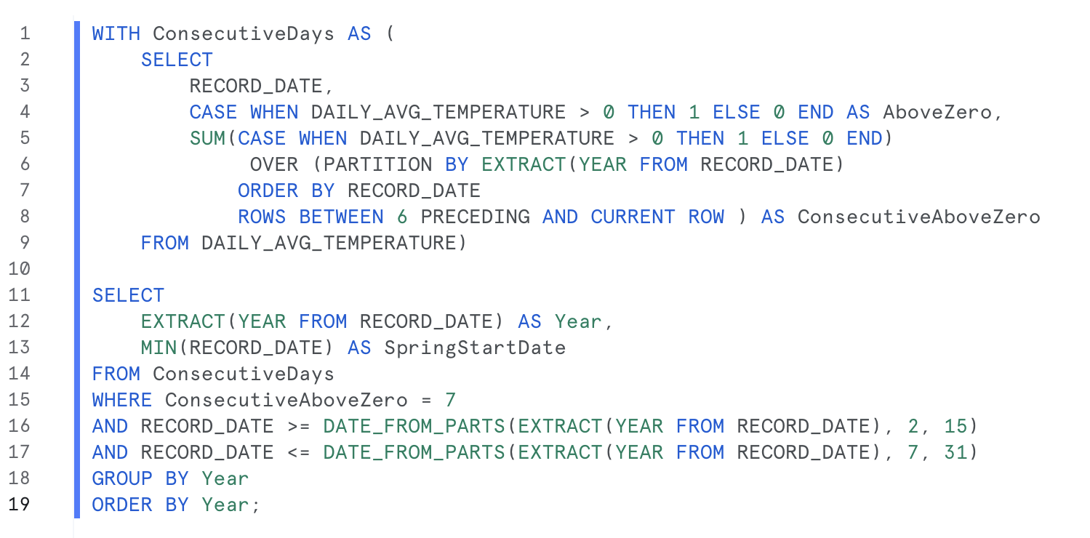
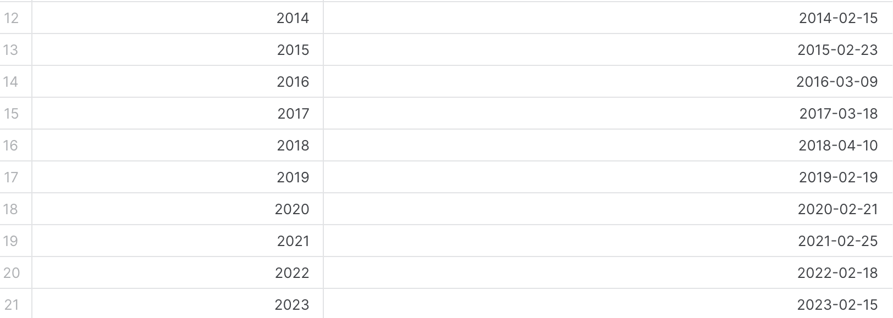
Q9

Slide 18
Anomalies
Q10: Which year saw the most weather anomalies?

Slide 19
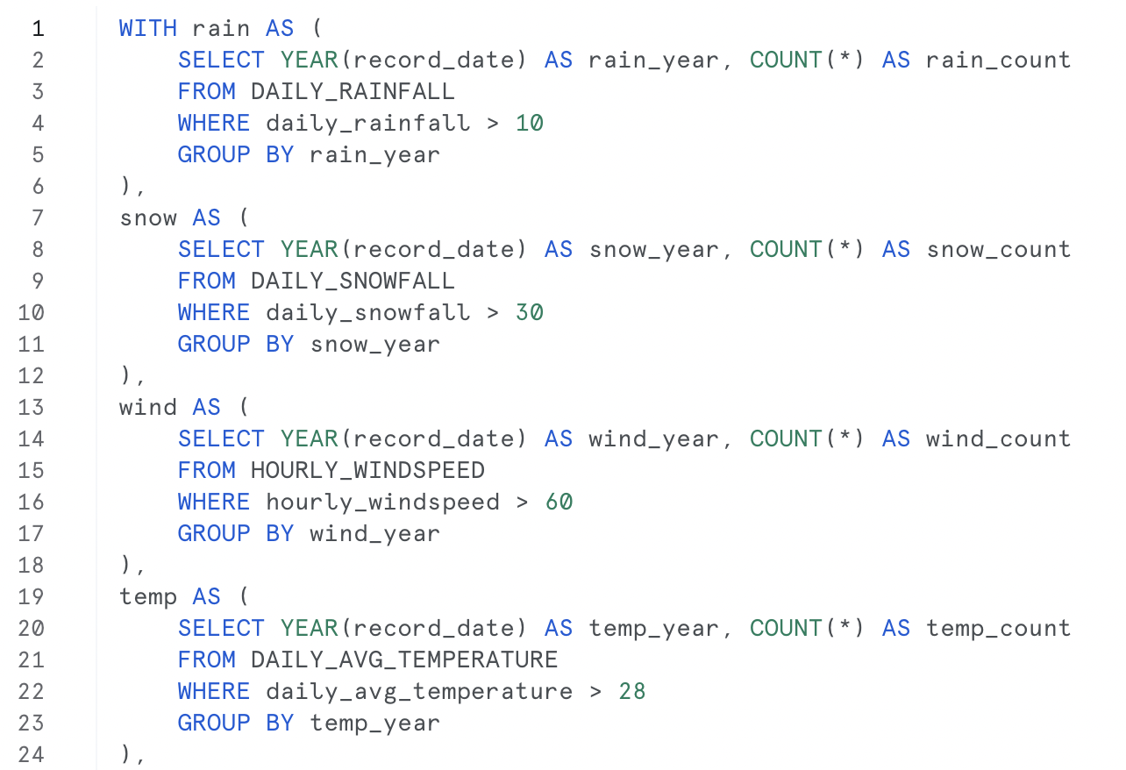
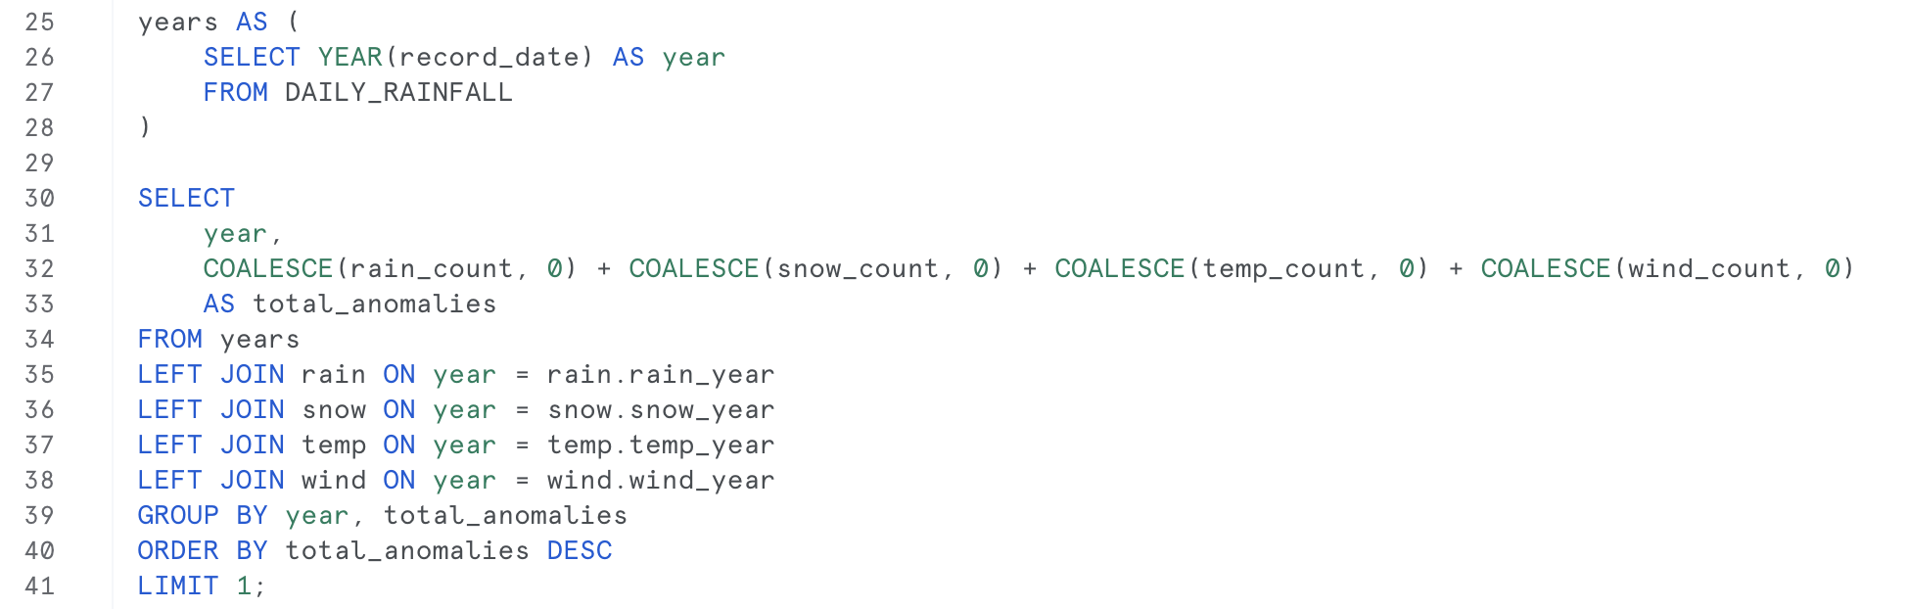
Q10

